Slide 1
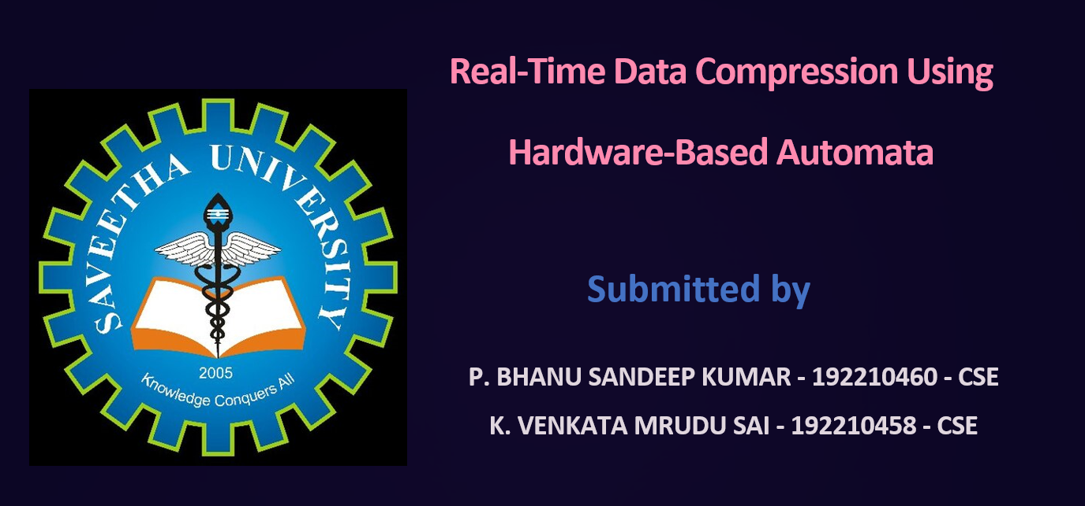

Slide 2

Real-Time Data Compression Using Hardware-Based Automata
Explore the innovative techniques of real-time data compression leveraging the power of hardware-based automata. Discover how these advanced systems can enable lightning-fast processing and optimize data transmission for a wide range of applications.

Slide 3
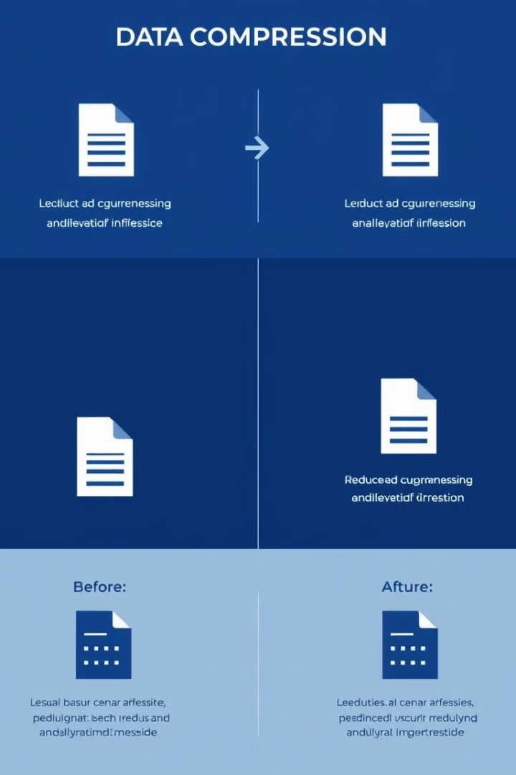
Introduction to Data Compression
1
Space Optimization
2
Bandwidth Savings
Data compression reduces the size of digital information, enabling more efficient storage and transmission.
Compressed data requires less network bandwidth, improving network speeds and reducing costs.
3
Diverse Applications
Data compression is essential for multimedia, cloud storage, IoT, and numerous other modern technologies.

Slide 4
Challenges of Real-Time Compression
Latency
Throughput
Efficiency
Compressing data in real-time requires ultra-fast processing to maintain low latency and responsiveness.
High-speed data streams demand compression algorithms that can keep up with massive data volumes.
Achieving optimal compression ratios while minimizing resource utilization is a delicate balance.

Slide 5

Overview of Hardware-Based Automata
1
Finite State Machines
Hardware-based automata leverage efficient Finite State Machines (FSMs) to process data in parallel.
2
ASIC Acceleration
Application-Specific Integrated Circuits (ASICs) provide hardware-level optimization for compression tasks.
3
Ultra-Fast Processing
Hardware automata can achieve compression speeds orders of magnitude faster than software-based solutions.

Slide 6

Finite State Machines for Data Compression
Pattern Recognition
Adaptive Encoding
FSMs excel at identifying recurring data patterns, a crucial aspect of effective compression.
Hardware FSMs can dynamically adjust their compression algorithms based on input data.
Parallel Processing
Energy Efficiency
Multiple FSMs can operate concurrently, enabling massive parallelization for high-throughput compression.
Hardware-based FSMs consume significantly less power than software-based compression solutions.

Slide 7

Designing Efficient FSM-Based Compressors
Optimized State Machines
Hardware-Software Co-Design
Careful design of FSM architectures can maximize compression ratios and minimize latency.
Integrating hardware and software components enables synergistic optimization of the compression system.
1
2
3
Adaptive Encoding
Dynamic adjustment of compression algorithms based on input data enhances overall efficiency.

Slide 8




Hardware Acceleration of Compression Algorithms
ASIC Acceleration
Application-Specific Integrated Circuits (ASICs) provide hardware-level optimizations for compression tasks.
FPGA Flexibility
Field-Programmable Gate Arrays (FPGAs) offer reconfigurable hardware for versatile compression solutions.
GPU Parallelization
Graphics Processing Units (GPUs) enable massively parallel compression for high-throughput applications.

Slide 9
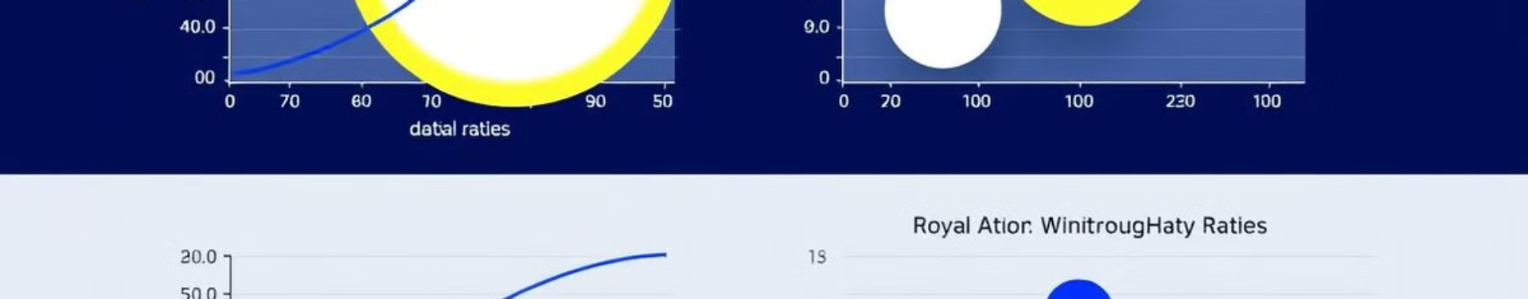
Compression Performance and Throughput
Compression Ratio
Throughput (Gbps)
Power Consumption (W)
2x - 4x
10 - 40
5 - 20
Hardware-based compression solutions can achieve exceptional performance, delivering high compression ratios and throughput while maintaining low power consumption.

Slide 10




Applications and Use Cases
Cloud Storage
Real-time compression enables efficient storage and transmission of massive data sets in the cloud.
Video Streaming
Hardware-accelerated compression ensures smooth, high-quality video delivery with minimal latency.
IoT Data
Compact data formats and fast processing are critical for real-time IoT applications.

Slide 11

Conclusion and Future Directions
As data volumes continue to soar, the need for efficient real-time compression will only grow. Hardware-based automata represent a promising frontier, delivering unprecedented performance and paving the way for innovative applications across diverse industries.

